Slide 1
Physically Realizable Adversarial Examples for LiDAR Object Detection Mohammed Kamran May 7, 2021
(Conference on Computer Vision and Pattern Recognition 2020)
Advisor: Alexander Lehner
Supervisor: PD Dr. Federico Tombari

Slide 2
Contents
Introduction
Related Work
Main Contributions
Experimental Setup
Results
Conclusion

Slide 3
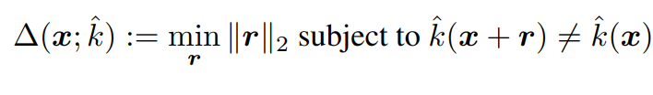
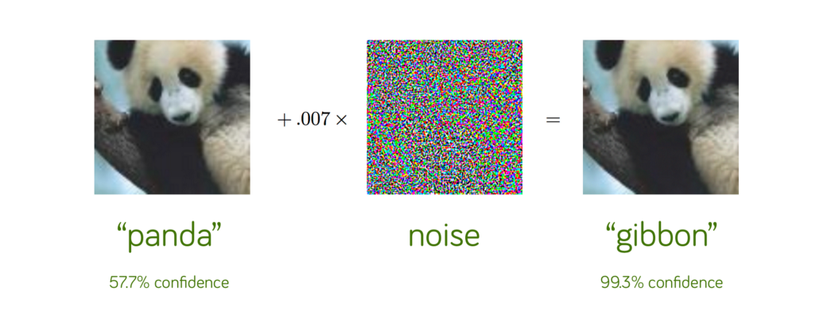
Introduction
Definition: Adversarial Attacks
For a given classifier, we define an adversarial perturbation as the minimal perturbation r that is sufficient to change the estimated label k(x):
Autonomous Systems rely on Point cloud data
Most attacks on 2d Flat Images
Attacking Machine Learning with Adversarial Examples (openai.com)

Slide 4
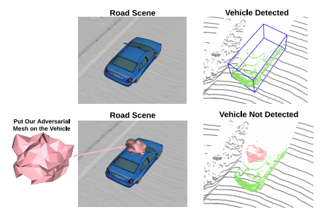
Introduction
Overview
1. Universal adversarial attack on LiDAR detectors with physically realizable 3D meshes.
2. Target vehicle invisible when placed on the Vehicle Roof top.
3. Evaluation against different target models
4. Successful defense mechanism with data Augmentation.

Slide 5
Contents
Introduction
Related Work
Main Contributions
Experimental Setup
Results
Conclusion

Slide 6
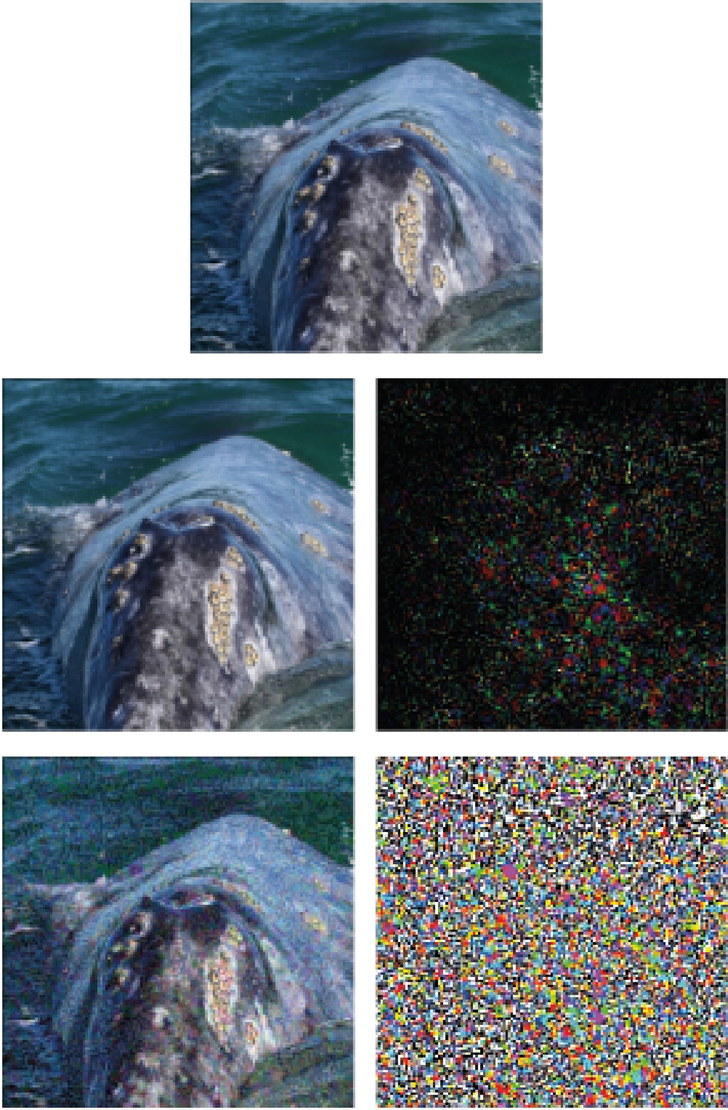
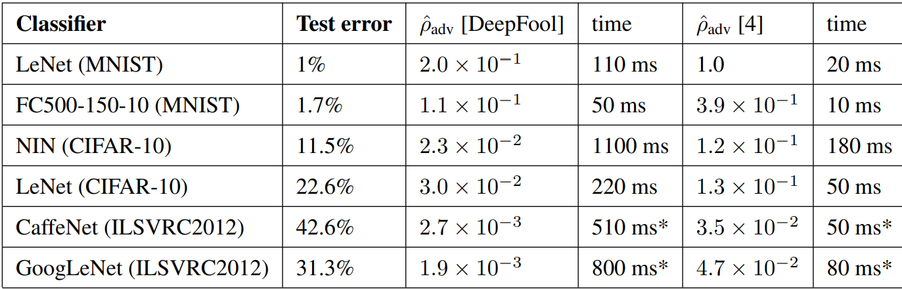
Related Work – Image Based Attack
Algorithm: DeepFool
Original: Whale, Classified: Turtle
Reliable and Efficient Computation
Data Augmentation for robustness
Results: Smaller pertubations
DeepFool — A simple and accurate method to fool Deep Neural Networks.

Slide 7
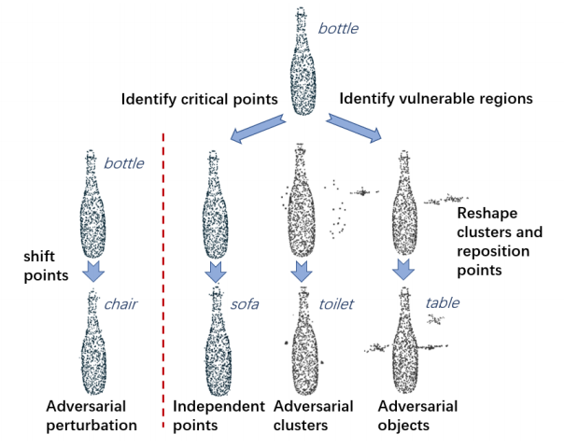
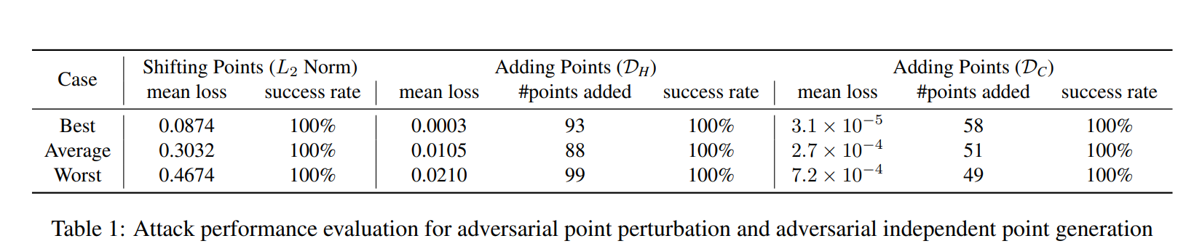
Related Work – Point Cloud Attack
Model – PointNet
Dataset – ModelNet40
Two Types – Adversarial Point perturbation and Point generation
Results - Success rate higher than 99%
Is it Practical ?
(Generating 3d adversarial point clouds)

Slide 8
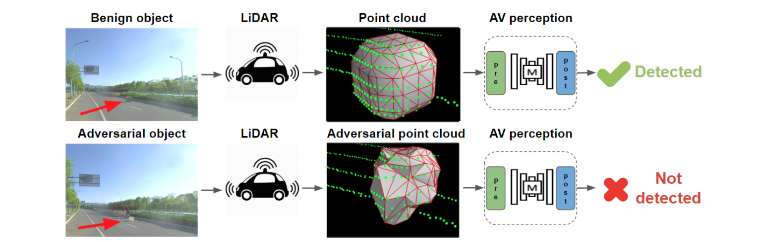
Related Work – Physical world attack
LidarAdv – Learns Adversarial mesh
Real world attack
Similar to our approach
What is the difference ?
Adversarial Objects Against LiDAR-Based Autonomous Driving Systems

Slide 9
Contents
Introduction
Related Work
Main Contributions
Experimental Setup
Results
Conclusion

Slide 10
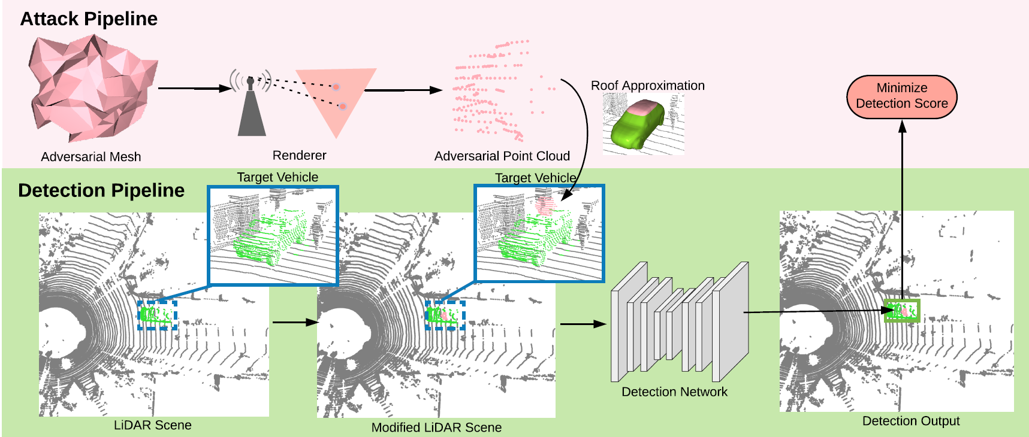
Main Contributions
1. Surface Parametrisation
2. Lidar Point Rendering
3. Rooftop fitting
4. Loss Function
5. Attack Algorithms

Slide 11
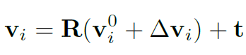
1. Surface Parametrization
Our Option – Mesh
Unit isotropic sphere with 162 vertices and 320 faces
Scale by 0.7m, 0.7m, 0.5m
2 . Lidar Point Rendering
Gamma rays sampled from location of mesh
Intersection of rays and mesh faces with Moller-Trumbore intersection algorithm
Union of the rendered adversarial points and the original points to create the modified scene

Slide 12
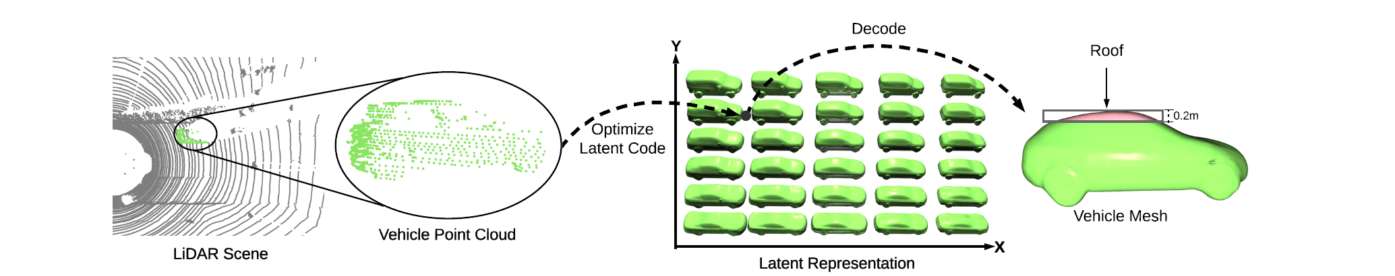
3. Rooftop Fitting
Represent collection of vehicles as Signed Distance functions.
Project to low dimension using PCA
Fit a CAD Model.
Use vertices in top 0.2m vertical range

Slide 13
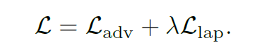
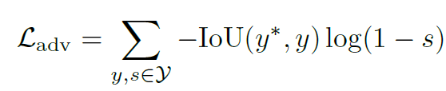
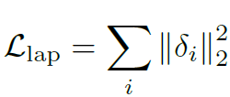
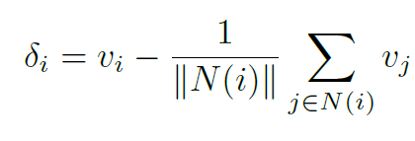
4. Loss Function
1. Adversarial Loss
Relevant if
1. Confidence score > 0.1
2. IoU with ground-truth > 0.1
Suppress all relevant proposals
Binary cross entropy
lamda = 0.001
2. Laplacian Loss
Regularise mesh
Maintain smoothness

Slide 14
5. Attack Algorithms
1. White box attacks –
Knowledge of model architectures
Gradient of Loss wrt mesh vertices
Projected gradient descent
2. Black box attacks –
Non-differentiable pre-processing stages
PIXOR has occupancy voxels
Genetic algorithm (Mutation and Crossover)

Slide 15
Contents
Introduction
Related Work
Main Contributions
Experimental Setup
Results
Conclusion

Slide 16
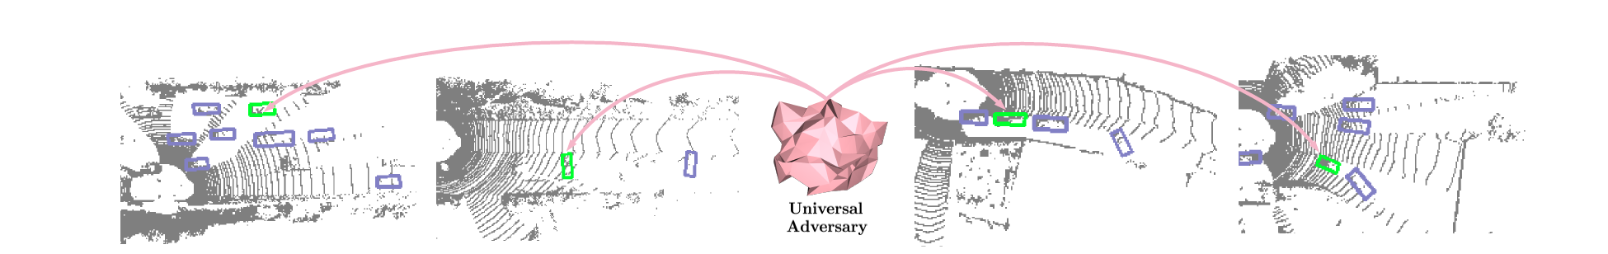
Experimental Setup
Dataset – KITTI (car class only)
Sensor - Velodyne HDL-64E
Target models
PIXOR
PIXOR(d)
PointRCNN
PointPillar

Slide 17
Contents
Introduction
Related Work
Physically Realizable Adversarial Examples
Experimental Setup
Results
Conclusion

Slide 18
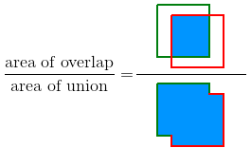
Results
Evaluation Metrics
Attack Success rate
- Percentage at the target vehicle is successfully detected originally but not detected after the attack.
2. Recall-IoU curve
- Recall = True Positives / (True Positives + False Negatives)
- IoU =

Slide 19
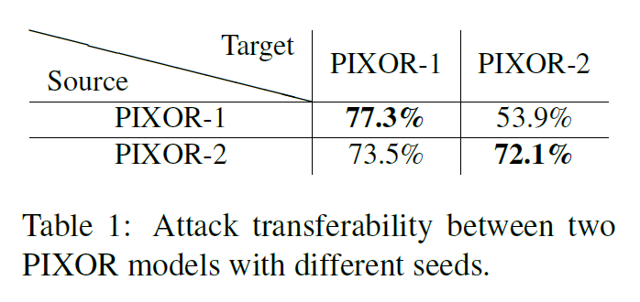
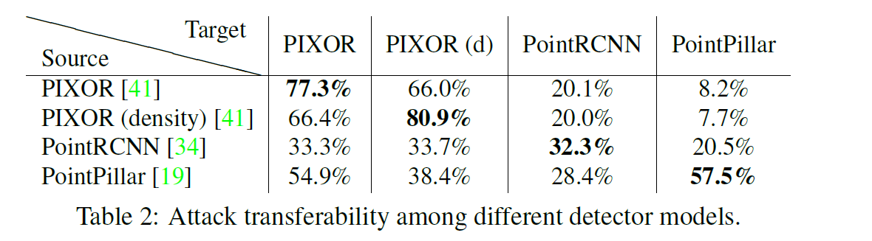
Results
Observations
1. Attack transferability in similar models
- Strong attack possible
2. Attack transferability across different architectures
- Attacks from PointRCNN and PointPillar
used to attack PIXOR and PIXOR(d),
not vice versa.
- Additional level of point-level
reasoning.

Slide 20
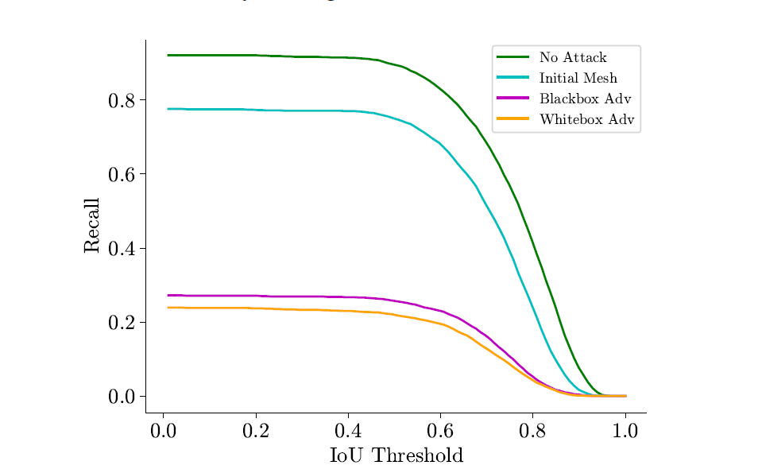
Results
Observations
2. Recall-IoU curve (PIXOR(d))
- Recall for different attacks at different IoU threshold
- IoU > 0.7 implies vehicle detected
- Similar performance on black and white box attacks
- Drop in Recall implies more False Negatives

Slide 21
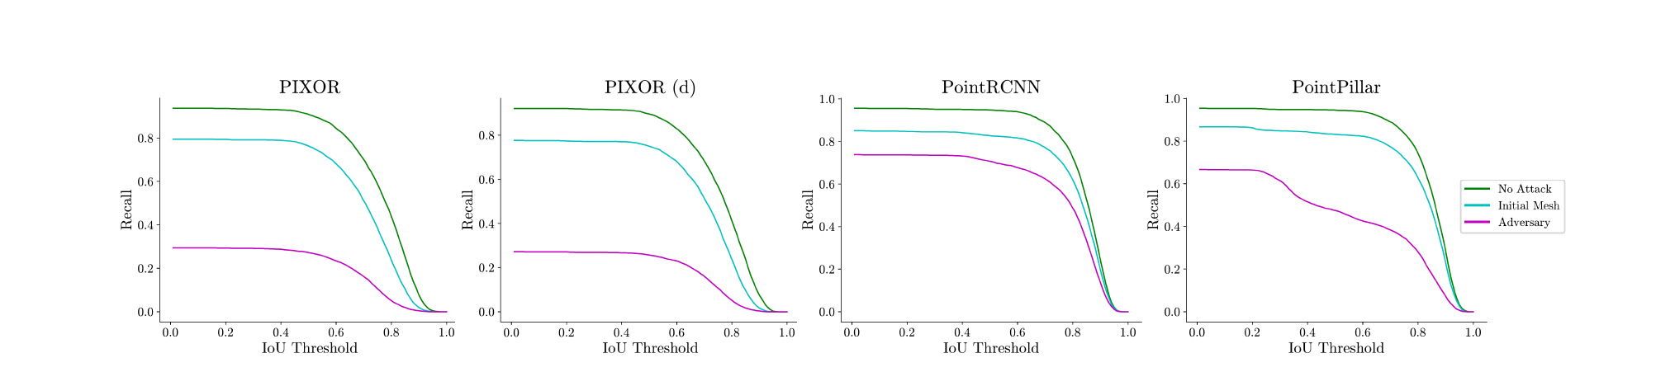
Results
Observations
2. Recall-IoU curve (All 4 models)
- Good attack on PIXOR models and PointPillar
- Weaker attack on PointRCNN
- PointRCNN treat each point as bounding box anchor

Slide 22
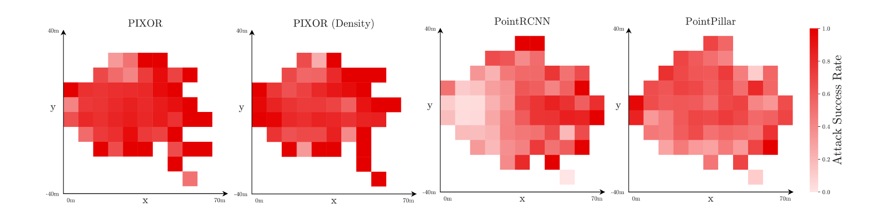
Results
Observations
Attack Success rate Visualization
- Vehicles close to Lidar sensor register more points and less attacked
- PointRCNN robust against attack near Lidar sensor

Slide 23
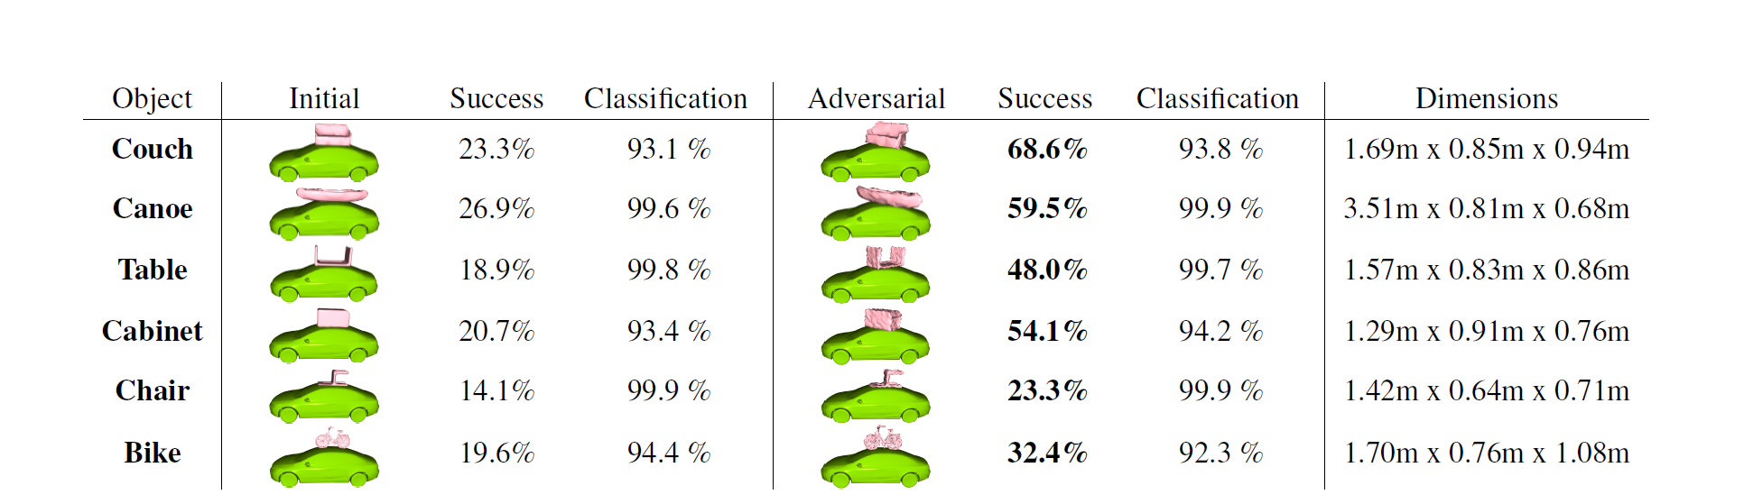
Results
Observations
More realistic experiment with common objects
Two Goals
Learn a universal adversary
Not pertubate much
6 common objects from ShapeNet
Maximum vertex perturbation to 0.03m
Weaker attack on Chair and Bike

Slide 24

Results
Defense Mechanism
Data Augmentation
One vehicle from each scene
Mesh from Gaussian distribution
Re-train an adversarial mesh

Slide 25
Conclusion
Robust,universal and physically realizable
Attack success rate of 80% at IoU 0.7 with strong Lidar detector
Defense using Data Augmentation not 100% secure
Need for robust models
Great research , more hope !

Slide 26
Thank you for your attention

Slide 27
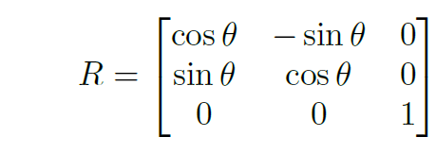
Surface Parametrization
Meshes - Efficient in space. Precise Rendering possible
R = Global Rotation matrix
t = Global Translation vector

Slide 28
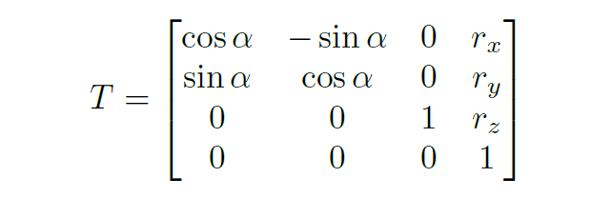
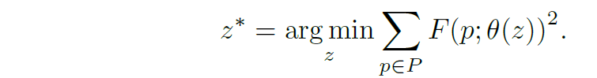
Rooftop Fitting
Internal collection of vehicles as Signed Distance Functions (SDF)
Optimise latent code z*

Slide 29
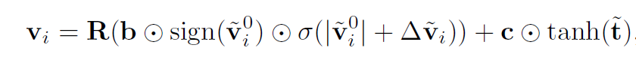
3. Attack Algorithms
1 . White box attacks
- b defines limit on size
- c defines linit on translation
- Normalised initial vertex position
- Normalised tran

Slide 30
3. Attack Algorithms
2 . Black Box attacks
- Maximise fitness score to generate population of candidates
- Highest fitness candidates preserved
- New parameteres sampled from old
- Add Gaussian noise with a mutation probability (0.0.1)
Parameters
Adam (lr = 0.005)
Mutation std (0.05)
Mutation prob (0.01)
Population size (16)
Average queries (100)

